Slide 1
SQL Server Internals and Architecture
Deepthi Goguri
August 14, 2020

Slide 2



About me
Database administrator with 7 years of experience.
Microsoft certified solution expert (MCSE).
Masters in Computer Technology.
Blogger for dbanuggets.com
@dbanuggets
dbanuggets@hotmail.com

Slide 3
Overview
ACID properties
Memory architecture
Cache
Life cycle of a query
Components of SQL engine

Slide 4
Internals: Why we care
Information about how queries are processed at each stage inside the SQL engine.
Helps you track down the performance issues and fix them efficiently.
Build confidence when managing database engine.
Helps in convincing your co-workers/managers of why they should take your ideas seriously.
The more you know, the better.

Slide 5

ACID properties

Slide 6
All queries in the transaction should either complete successfully or all rollback.
Atomicity
Database should be consistent after every single transaction.
Consistency
ACID
Multiple transactions occur independently without interference.
Isolation
Changes that have been committed to the database should remain even if the system failure occurs.
Durability

Slide 7
What components of SQL Engine ensures ACID property?
Atomicity- Parse component
Consistency- Parse and binder
Isolation- Lock manager
Durability- Transaction log

Slide 8
Example
ID | Balance
1 | $500
2 | $100
Send $100 from Account 1 to Account 2
ID | Balance
1 | $400
2 | $100
BEGIN TRAN
UPDATE ACCOUNT SET BALANCE=BALANCE-100 WHERE ID=1 AND BALANCE >100

Slide 9
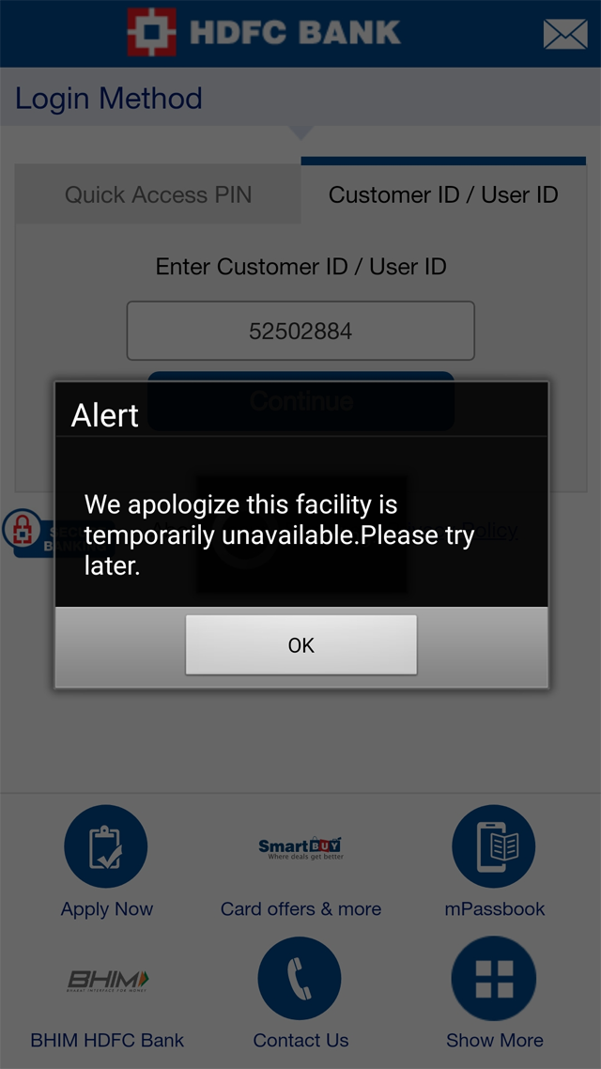
www.bank.com
www.bank.com

Slide 10
Example
Once the server restarts,
uncommitted transactions are rolled back.
ID | Balance
1 | $400
2 | $100
ID | Balance
1 | $500
2 | $100

Slide 11
SQL Server memory architecture
SQL Server
Thread stack
Caches
Fixed memory
Plan
Cache
Buffer
Pool
Other
Caches
Columnstore
Fixed
Memory
SQLServer.exe overhead
In-Memory
OLTP
Columnstore indexes
Thread stacks
Connections to SQL Server
Memory-optimized tables
Stored procedures, query plans etc.;
Log cache, TokenAndPermUserStore cache.
Holds 8kb data and index pages.

Slide 12
How memory is managed?
LRU-K(Least recently used algorithm)
2 processes:
Lazy writer
Ghost cleanup

Slide 13
Plan cache
Plan 1
Lazy writer
16
18
17
18
Complexity countdown value
Complexity code value
Plan 2
9
8
9
7
9
Ghost Cleanup
Plan 3
2
2
1
0

Slide 14


Buffer pool
8kb pages
Hold 8kb page.
Indexes
Help reduce I/O.
Speeds up query process.
Buffer pool
Checkpoint process.
CHECKPOINT
Database files
Dirty pages
Buffer pool

Slide 15
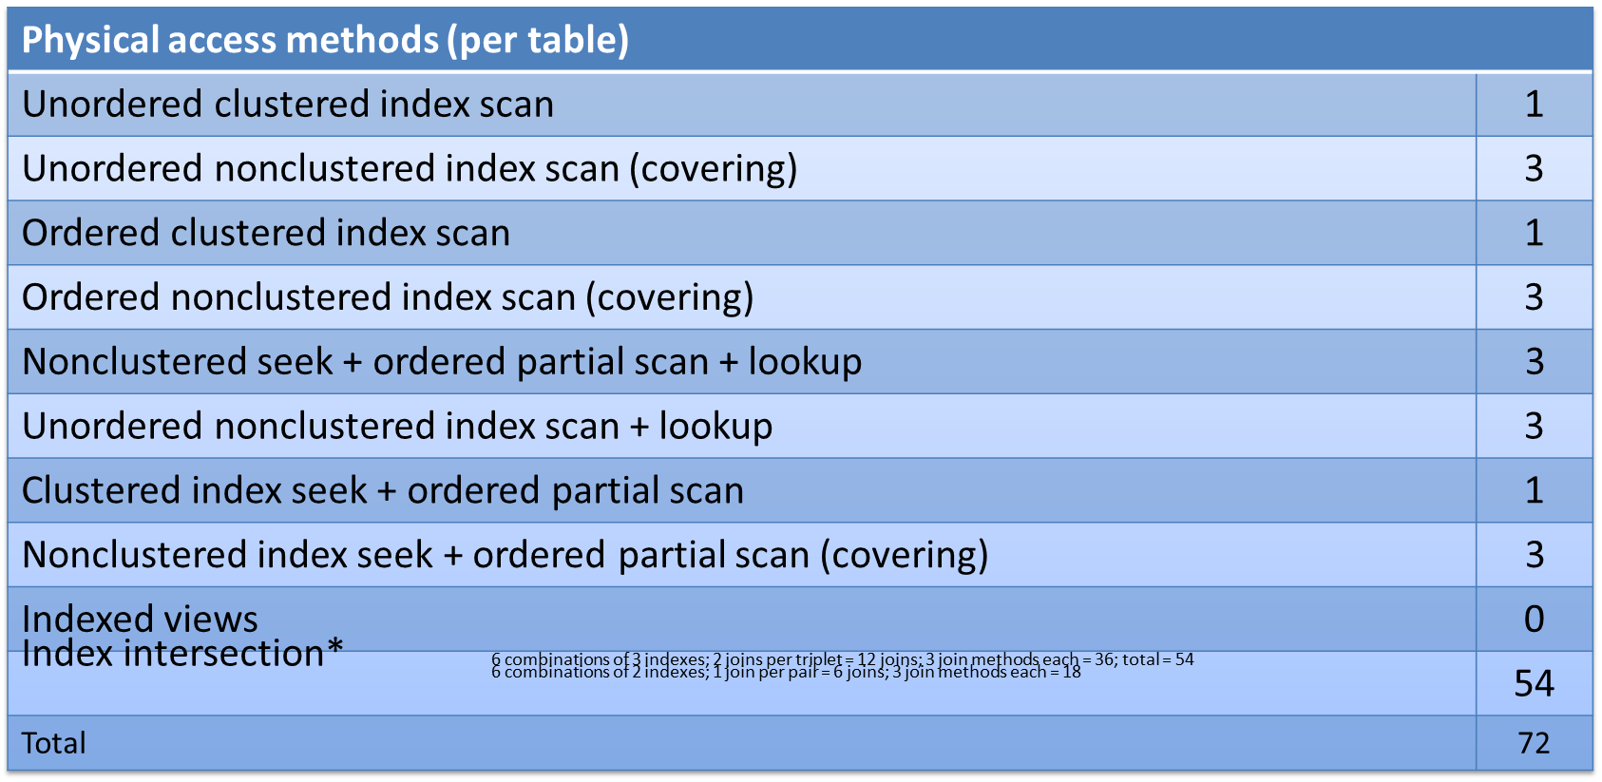
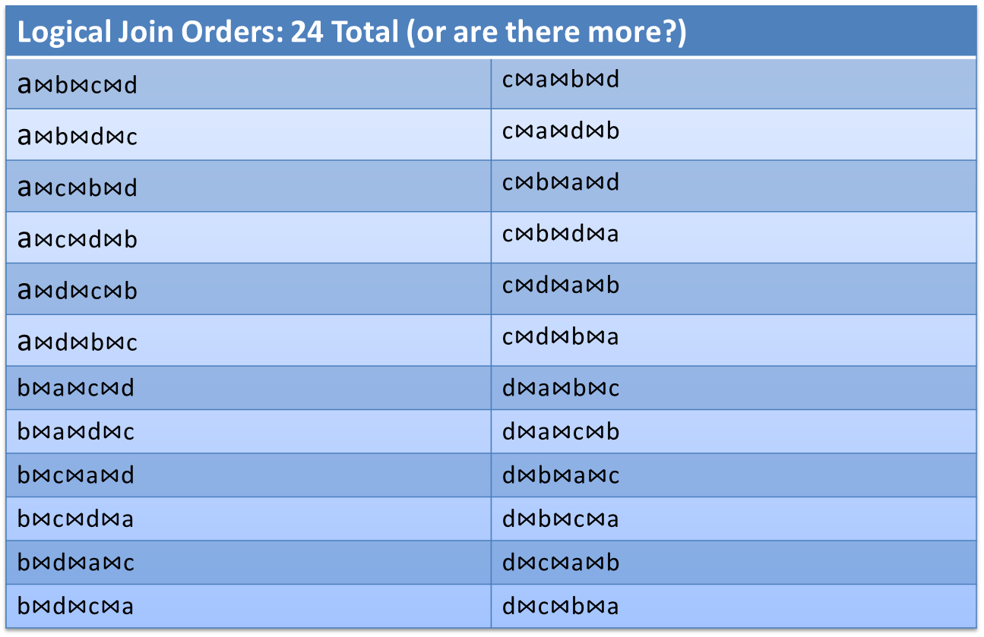
How optimizer choose plan?
Good enough plan, not the best plan.
SELECT...
FROM a
JOIN b ON ...
JOIN c ON ...
JOIN d ON ...
Clustered index and 3 non-clustered indexes each.
72 Possible physical data access
methods
120 Possible logical join orders
Physical joins possible per
logical join
+ May require intermediate sort operation
--- --------------------------------
= 25,920 possible plans?!?
Credits: Kevin Kline
Twitter: @kekline

Slide 16
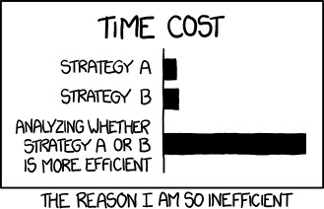
How optimizer choose plan?
Credits: Kevin Kline
Twitter: @kekline

Slide 17

Life Cycle of a Query

Slide 18


SQL OS
First step
Relational engine
Second step
SNI
Join heuristics
Parser
Binder
Load metadata
Simplification
Trivial plan
Search phases
0, 1, 2
Tran log
Database files
R
RAM
Storage engine
Plan cache
Buffer pool
Third step
Access methods
Transaction mgr
Buffer mgr
Success message to user

Slide 19
Select query
SQL OS
SNI
SQL operating system.
Assigns server process id (SPID) to incoming connections.
Unwraps the TDS packet.
SQL Server network interface.
Establishes network connection via network protocol.
TCP/IP, shared memory, named pipes.
SQL query wrapped in tabular data stream packet (TDS).

Slide 20
Parser
Binder
Simplification
Trivial plan
Algebrizer/Normalizer.
Metadata discovery, name resolution.
Checks user permissions.
Data type resolution (UNION).
Aggregate binding.
Updates parse tree in the cache.
Last step for pre-optimization.
Query considered as simple.
Doesn’t cache the plan.
Simplify query for easy process. For example:
Convert subqueries to joins, convert inner join to outer join.
Contradiction detection.
Updates the parse tree.
Validates syntax.
Identify variable declaration.
Views are expanded.
Builds initial parse tree.
Plan cache
Buffer
pool
First step
RAM

Slide 21
Load
metadata
Join
heuristics
Search phases
0, 1, 2
Index statistics and histograms.
Auto-created statistics.
Cardinality estimates.
SQL Server and windows collation.
SET option settings.
Updates the parse tree.
Gets the good enough plan, not the best plan.
Phase 0 – Transactional plan
Phase 1 – Quick plan
Phase 2 – Full plan
Reorders joins in a way that reduces the number of returned rows as early in the process as possible.
Updates the parse tree.
Plan cache
Buffer
pool
RAM
Hashed
Second step

Slide 22
Optimizer search phases
Transactional Plan
Pre-optimization stage.
Quick plans asap.
Small queries max 3 tables
basic heuristics.
Phase 0
Quick Plan
Queries for max 8 tables.
More transformation rules than phase 0.
Phase 1
Full plan
Complex queries.
Parallelism, spills & spools to tempdb.
All transformation rules are unlocked.
Phase 2

Slide 23
Read transaction
Check for required pages in memory.
Any required pages grabbed from database file to data cache.
Acquire shared lock (select).
Access methods
Transaction mgr
Buffer mgr
Lock manager and Log manager
For read transaction, Lock manager will be invoked.
Request buffer pool to acquire shared lock on resources.
Doesn’t perform any operation.
Analyze how the required data can be accessed from database files.
Plan cache
Buffer
pool
Tran log
Database files
RAM
Third step

Slide 24
Write transactions
Acquire Exclusive lock.
Check for required pages in memory.
Additional required pages grabbed from database file to data cache.
Invokes every few minutes by SQL Server.
Pushes dirty pages to disk and hardens to disk.
Access methods
Transaction mgr
Buffer mgr
Lock manager and log manager.
For write transaction, first log and next lock manager will be invoked.
Request buffer pool to acquire shared lock on resources.
Doesn’t perform any operation.
Analyze how the required data can be accessed from database files.
CHECKPOINT
Plan cache
Buffer pool
Tran log
Database files
RAM
Third step

Slide 25



Slide 26
Summary
ACID properties with an example
Overview of memory architecture
How memory is managed?
Life cycle of a query
Components of SQL engine

Slide 27
Resources
https://kevinekline.com/slides/sql-server-internals-architecture/
https://www.sql.kiwi/2012/04/query-optimizer-deep-dive-part-1.html
Pro SQL Server Internals 2nd ed. Edition by by Dmitri Korotkevitch
https://eightkb.online/detail.html?session_id=197300

Slide 28


